Slide 1
SOLAR TRACKER
PRAVINRAJ M A (7376211EE159)
RAHUL K (7376211EE160)
ALLEN JESSINTH M (7376211EE104)
SHAILESH BABU K R (7376211EE182)
Notes:
IOT
\\\\\

Slide 2
Abstract
As the non renewable energy resources are decreasing, use of renewable resources for producing electricity is increasing. Solar panels are becoming more popular day by day. We have already read a post about how to install solar panel for home. Solar panel absorbs the energy from the Sun, converts it into electrical energy and stores the energy in a battery.This energy can be utilized when required or can be used as a direct alternative to the grid supply. Utilization of the energy stored in batteries is mentioned in below given applications.
The position of the Sun with respect to the solar panel is not fixed due to the rotation of the Earth. For an efficient usage of the solar energy, the Solar panels should absorb energy to a maximum extent.This can be done only if the panels are continuously placed towards the direction of the Sun. So, solar panel should continuously rotate in the direction of Sun.

Slide 3
Problem Statement Addressed
Due to the rotation of earth, the solar energy inform of sunlight will not reach the earth in same direction. Solar panel is need to be positioned either east(can’t produce sufficient energy during evening time) faced or west(can’t produce sufficient energy during morning time) faced, which results in the reduction of energy production.

Slide 4
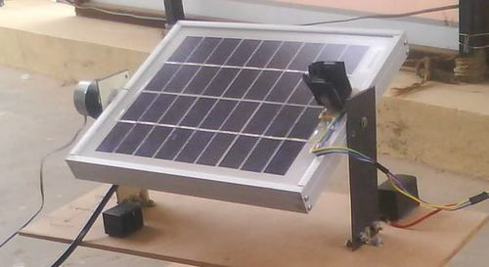
Existing Solution to the Problem Addressed
The problem could be avoided using solar tracker, as mentioned in the figure.

Slide 5
Proposed Solution to the Problem Addressed
Solar panel is need to be positioned either east(can’t produce sufficient energy during evening time) faced or west(can’t produce sufficient energy during morning time) faced, which results in the reduction of energy production.

Slide 6
Project Work Plan
The main control circuit is based upon NodeMcu microcontroller. Programming of this device is done in the manner that the LDR sensor, in accordance with the detection of the sun rays, will provide direction to the DC Motor that in which way the solar panel is going to revolve. Through this, the solar panel is positioned in such a manner that the maximum amount of sun rays could be received. In comparison with the other motors, DC motor is the simplest and the suave one, the torque of which is high and speed of which is slow enough. We can program it for changing the direction notwithstanding the fact that it rotates only in one direction subject to exception as far as programming is concerned. 1985, first time ever it was witnessed for production of the silicon solar cells with an efficiency of 20%. Though a hike in the efficiency of the solar panel had a handsome increase still perfection was a far-fetched goal for it. Below 40%, most of the panels still hover to operate. Consequently, peoples are compelled to purchase a number of panels in order to meet their energy demands or purchase single systems with large outputs. Availability of the solar cells types with higher efficiencies is on provided they are too costly to purchase.

Slide 7
Ways to be accessed for increasing solar panel efficiencies are a plethora in number still one of the ways to be availed for accomplishing the said purpose while reducing costs, is tracking.Tracking helps in the wider projection of the panel to the Sun with increased power output. It could be dual or single axis tracker. Duality ragged up with better compatibility as far as tracking of the sunlight from both the axis is concerned. Commercially single tracker is cheaper to use through booming of power is considerable and therefore a minuscule increase in the price is worthy and acceptable, provided maintenance cost should float around on an average level

Slide 8
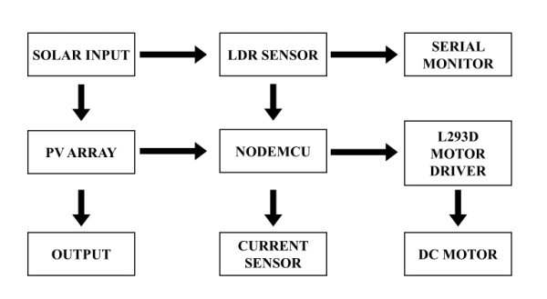
Block Diagram and/or Circuit Diagram

Slide 9
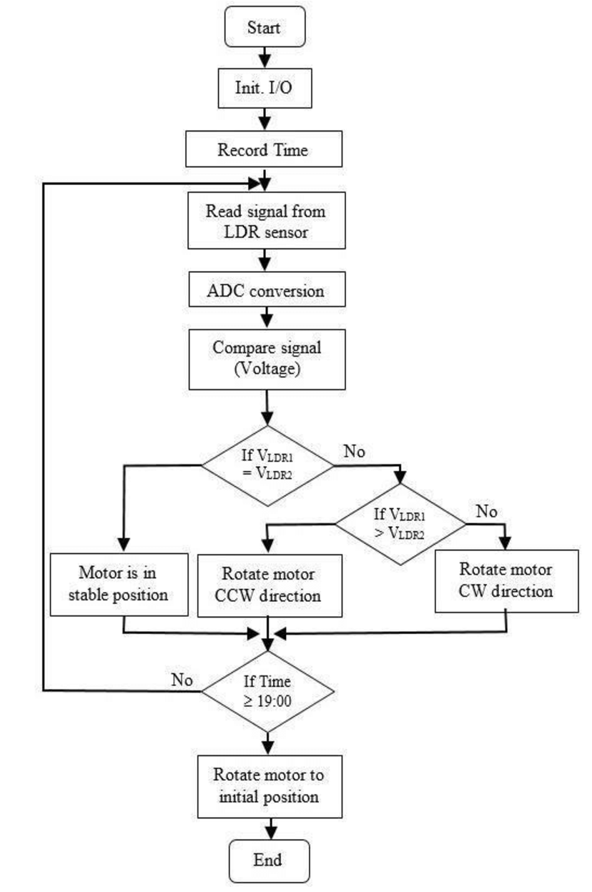
Flow Chart

Slide 10
Effective utilization of the Modern Tool & Cloud
It is a completely hardware based projects. So, there is no codings or websites used in this project. The microcontroller used in this project(ATmega328) has specific codings.

Slide 11
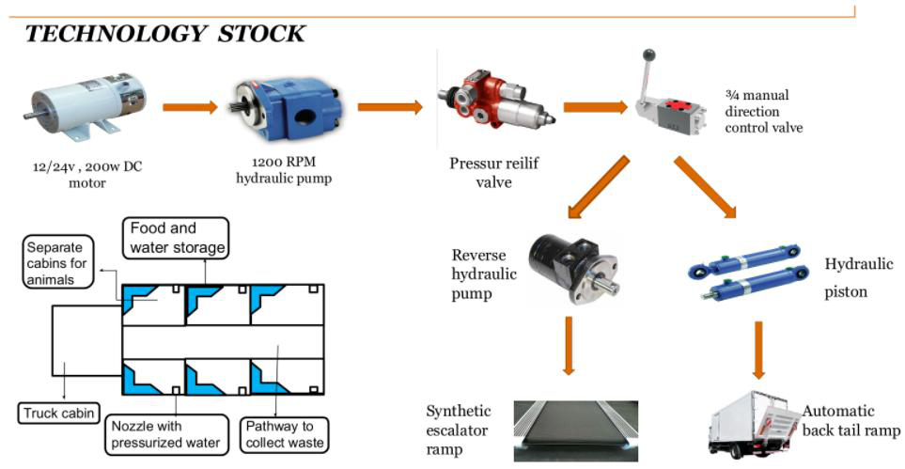
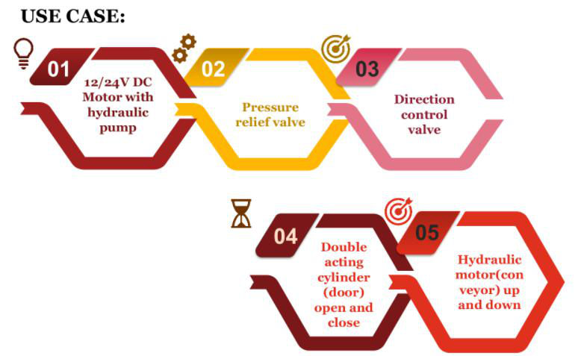
Technology stack & use case

Slide 12
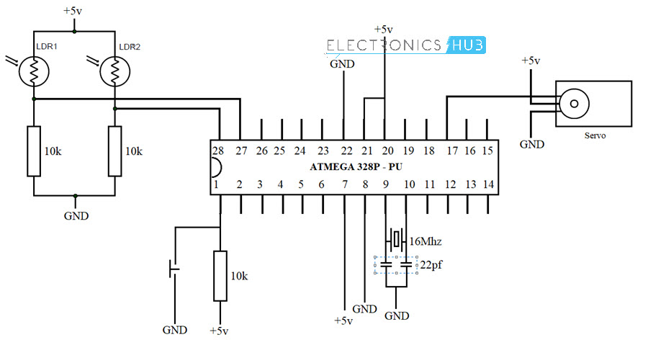
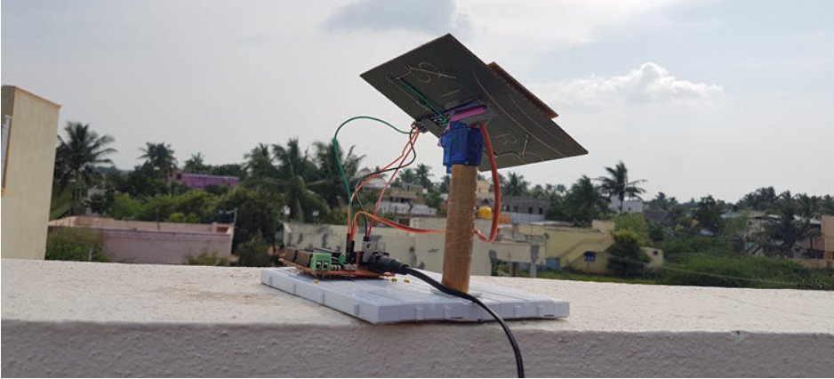
Prototype & Sample Output

Slide 13
Analysis of Results & Discussions
How Sun Tracking Solar Panel Works?
Power on the circuit and place the set up directly under the Sun (on the rooftop).
Based on the light falling on the two LDRs, the ATmega328 Microcontroller changes the position of the Servo Motor which in turn moves in the panel.
Advantages of Sun Tracking Solar Panel
The solar energy can be reused as it is non-renewable resource.
This also saves money as there is no need to pay for energy used (excluding the initial setup cost)
Helps in maximizing the solar energy absorption by continuously tracking the sun.
Limitations of Sun Tracking Solar Panel Circuit
Though solar energy can be utilized to maximum extent this may create problems in rainy season.
Although solar energy can be saved to batteries, they are heavy and occupy more space and required to change time to time.
They are expensive.

Slide 14
Cost Benefit Analysis (List of Components / Service Used)
BUDGET: Rs.2000
S.No | Component Name | Specification (IC number or Range or Value) | Unit Cost | Total Cost
1 2 | SOLAR PANEL 16MHz CRYSTAL | 6 Volt – | 300 50 | 300 50
3 4 | MICROCONTROLLER CAPACITORS-2 | ATmega328 22pF | 800 40 | 800 40
5 6 | LIGHT DEPENDENT DIODE(LDR)-2 PUSH BUTTON | — — | 100 30 | 200 30
7 8 | RESISTORS BREADBOARD | 10K OHM — | 40 100 | 40 100
9 | SERVO MOTOR | — | 300 | 300

Slide 15
References
Ariponnammal, S. and Natarajan, S. (1994) “Transport Phonomena of SmSel – Xasx”, Pramana – Journal of Physics Vol.42, No.1, pp.421-425.
Barnard, R.W. and Kellogg, C. (1980), “Applications of Convolution Operators to Problems in Univalent Function Theory”, Michigan Mach, J., Vol.27, pp.81-94.
Shin, K.G. and Mckay, N.D. (1984), “Open Loop Minimum Time Control of Mechanical Manipulations and its Applications‟, Proc. Amer. Contr. Conf., San Diego, CA, pp. 1231-1236.
(sample references, the same format should be followed throughout)

